Slide 1





Credix
P2P Borrowing-Lending Platform
The Future of Peer-to-Peer Lending and Borrowing

Slide 2

Credix
What is borrowing lending platform?
Lenders: Deposit money and earn interest.
Borrowers: Uses collateral or flash loans.
Lending Systems: Smart contracts automate lending, borrowing, and liquidation

Slide 3

Credix
Problem
🔹 Fixed Interest Rates → Static Pricing, No Negotiation
🔹 Liquidity Issues → Funding Gaps, Unstable Access
🔹 Limited Flexibility → One-Size-Fits-All, Inflexible Terms

Slide 4
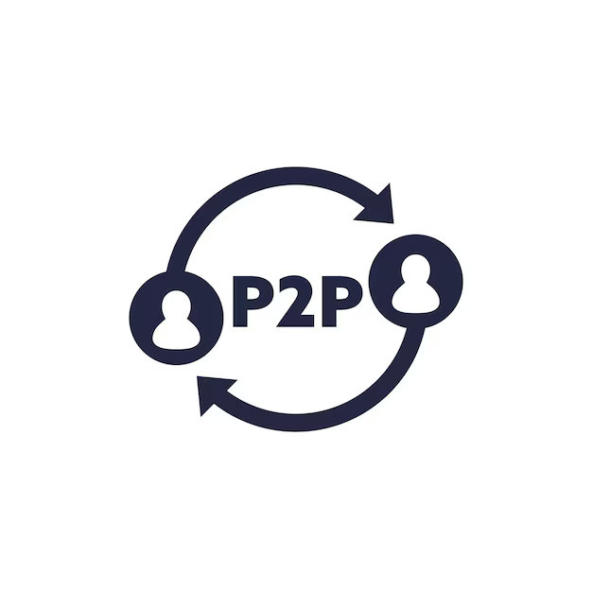
Credix
Credix P2P Approach
The lender can set any rules they want
The borrower can borrow from anyone they choose
There is no liquidity issue, and it is a more decentralized credit system

Slide 5
Credix
Lenders and borrowers set their own interest rates | Interest rates are fixed, set by the platform
No liquidity pool limitations. | Liquidity may be limited
Terms are customizable | Fixed terms and rates
Collateral terms can be customized. | Collateral ratios are usually fixed, often 150% or more
P2P Lending Pool Lending

Slide 6
Credix
How to Work?
1- Lender Creates a New Offer
2- Borrower Views and Selects an Offer
3- Borrower Repays the Loan
4- Unpaid Loans: Lender Claims Collateral

Slide 7
Credix
How to Work?
Native
Stable
1 UNIT0 = 1 UUSDT
We mint UUSDT on testnet

Slide 8
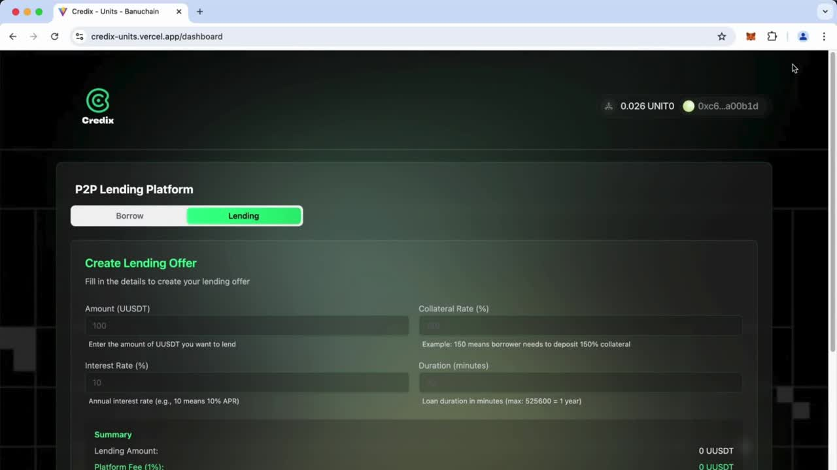
Credix

Slide 9

Credix
Future goals
Currently, we have used the UUSDT token that we issued as collateral, but Oracle integration will be made in the future.
A cross-chain lending mechanism
A bidirectional credit system where both lenders and borrowers can set their own rules.

Slide 10




Credix
Team
Mertcan Köse
Veysel Arslanbuğul
Mekan Çelebi
Serhat Özen

Slide 11

Credix
THANK YOU!

